Slide 1
CST-104
Object Oriented
Programming In C++
Fourth Edition
Robert Lafore

Slide 2
CHAPTET - 5 FUNCTIONS

Slide 3
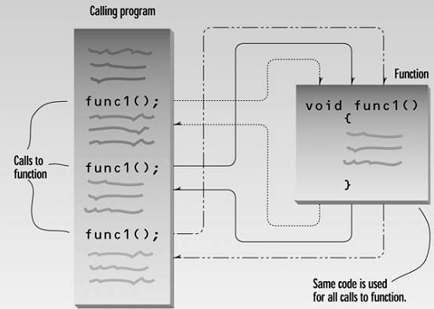
Function
groups a number of program statements into a unit and gives it a name
can then be invoked from other parts of the program

Slide 4
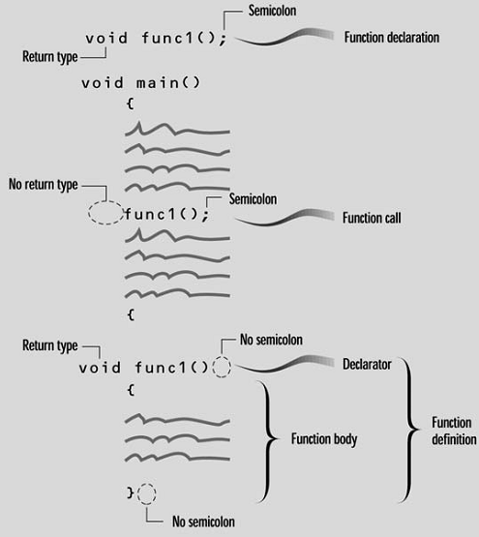
Function Syntax
Function Declaration
Call to Function
Function Definition

Slide 5
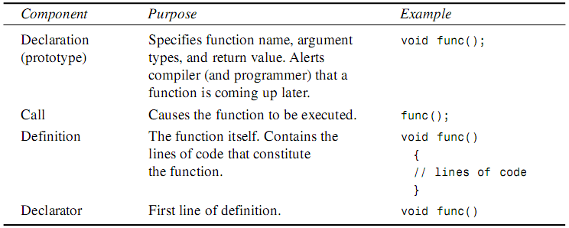
Function Component

Slide 6
Simple Function
// Page 163 - table.cpp
// demonstrates simple function
#include <iostream.h>
void starline(); //function declaration (prototype)
void main()
{ starline(); //call to function
cout << "Data type Range" << endl;
starline(); //call to function
cout << "char -128 to 127" << endl
<< "short -32,768 to 32,767" << endl
<<"int System dependent" << endl
<< "long -2,147,483,648 to 2,147,483,647" << endl;
starline(); //call to function
}
//--------------------------------------------------------------

Slide 7
Simple Function – Cont’d
// starline()
// function definition
void starline() //function declarator
{
for(int j=0; j<45; j++) //function body
cout << '*';
cout << endl;
}
Remark: Eliminating Function Declarations
// Page 167 Example
// table2.cpp

Slide 8
Passing Arguments to Functions
An argument is a piece of data (an int value, for example) passed from a program to the function.
Arguments allow a function to operate with different values, or even to do different things, depending on the requirements of the program calling it.
Passing by Value - where the function works with a copy of the argument
Passing Constants
Passing Variables
Passing by Reference - where the function works with the original argument in the calling program

Slide 9
Passing Constants
#include<iostream.h>
void repchar(char, int);
int main()
{
repchar('-',43);
cout<<"Data Type Range"<<endl;
repchar('=',23);
cout<<"char -128 to 127"<<endl
<<"short -32768 to 32,767"<<endl
<<"int System dependent"<<endl
<<"long -2,147,483,648 to 2,147,483,647"<<endl;
repchar('-',43);
return 0;
}
void repchar(char ch,int n )
{
for(int j=0;j<n;j++)
cout<<ch;
cout<<endl;
}

Slide 10
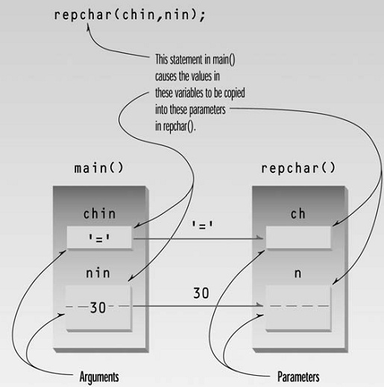
Passing Variables
#include<iostream.h>
void repchar(char,int);
int main()
{
char chin;
int nin;
cout<<"Enter a character:";
cin>>chin;
cout<<"Enter number of times to repeat it:";
cin>>nin;
repchar(chin,nin);
return 0;
}
void repchar(char ch,int n )
{
for(int j=0;j<n;j++)
cout<<ch;
cout<<endl;
}
Passing by Value

Slide 11
Returning Values from Functions
#include<iostream.h>
float lbstokg(float);
int main()
{
float lbs,kgs;
cout<<"Enter your weight in pounds:";
cin>>lbs;
kgs=lbstokg(lbs);
cout<<"Your weight in kilograms is"<<kgs<<endl;
return 0;
}
float lbstokg(float pounds)
{
float kilograms=0.453592*pounds;
return kilograms;
}

Slide 12
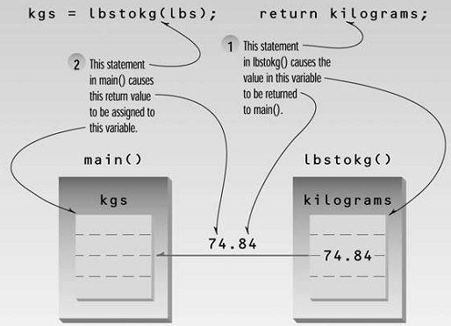
Returning Values from Functions
Notes:
When a function completes its execution, it can return a single value to the calling program.
When a function returns a value, the data type of this value must be specified .

Slide 13
Structures as Arguments
#include<iostream.h>
struct Distance
{ int feet;
float inches;
};
void engldisp(Distance);
int main()
{ Distance d1,d2;
cout<<"Enter feet:";
cin>>d1.feet;
cout<<"Enter inches:";
cin>>d1.inches;
cout<<"\nEnter feet:";
cin>>d2.feet;
cout<<"Enter inches:";
cin>>d2.inches;
cout<<"\nd1= ";
engldisp(d1);
cout<<"\nd2= ";
engldisp(d2);
cout<<endl;
return 0;
}
void engldisp(Distance dd)
{
cout<<dd.feet<<"\'“
<<dd.inches<<"\"";
}

Slide 14
Returning Structure Variables
#include<iostream.h>
struct Distance
{ int feet;
float inches; };
Distance addengl(Distance,Distance);
void engldisp(Distance);
int main()
{ Distance d1,d2,d3;
cout<<"Enter feet:";
cin>>d1.feet;
cout<<"Enter inches:";
cin>>d1.inches;
cout<<"Enter feet:";
cin>>d2.feet;
cout<<"Enter inches:";
cin>>d2.inches;
d3=addengl(d1,d2);
cout<<endl;
engldisp(d1);
cout<<"+";
engldisp(d2);
cout<<"=";
engldisp(d3);
cout<<endl;
return 0;
}

Slide 15
Returning Structure Variables
Distance addengl(Distance dd1,Distance dd2)
{
Distance dd3;
dd3.inches=dd1.inches+dd2.inches;
dd3.feet=0; if(dd3.inches>=12.0)
{
dd3.inches-=12.0;
dd3.feet++;
}
dd3.feet+=dd1.feet+dd2.feet;
return dd3;
}
void engldisp(Distance dd)
{
cout<<dd.feet<<"\'-"<<dd.inches<<"\"";
}

Slide 16
Passing by Reference
A reference provides an alias—a different name—for a variable.
#include<iostream.h>
int main()
{
void intfrac(float,f loat&, float&);
float number,intpart,fracpart;
do{
cout<<"\nEnter a real nmber:";
cin>>number;
intfrac(number, intpart, fracpart);
cout<<"Integer part is"<<intpart
<<", fraction part is <<fracpart<<endl;
}while(number!=0.0);
return 0;
}
void intfrac(float n, float& intp, float& fracp)
{
long temp=static_cast<long>(n);
intp=static_cast<float>(temp);
fracp=n-intp;
}

Slide 17
Passing by Reference
#include<iostream.h>
void order(int&,int&);
int main()
{
//void order(int&,int&);
int n1=99,n2=11;
int n3=22,n4=88;
order(n1,n2);
order(n3,n4);
cout<<"n1="<<n1<<endl;
cout<<"n2="<<n2<<endl;
cout<<"n3="<<n3<<endl;
cout<<"n4="<<n4<<endl;
return 0;
}
void order(int & num1,int& num2)
{
if(num1>num2)
{
int temp=num1;
num1=num2;
num2=temp;
}
}

Slide 18
Passing Structures by Reference
#include<iostream.h>
struct Distance
{ int feet;
float inches; };
void scale(Distance&, float);
void engldisp (Distance);
int main()
{ Distance d1={12,6.5};
Distance d2={10,5.5};
cout<<"d1= ";
engldisp(d1);
cout<<"\nd2= ";
engldisp(d2);
scale(d1,0.5);
scale(d2,0.25);
cout<<"\nd1= ";
engldisp(d1);
cout<<"\nd2= ";
engldisp(d2);
cout<<endl;
return 0;
}
void scale(Distance& dd , float factor)
{
float inches=(dd.feet*12+dd.inches)*factor;
dd.feet=static_cast<int>(inches/12);
dd.inches=inches-dd.feet*12;
}
void engldisp(Distance dd)
{ cout<<dd.feet<<"\'-"<<dd.inches<<"\""; }

Slide 19
Functions
Functions can return only one value. Functions ordinarily return by value, but they can also return by reference
An overloaded function is actually a group of functions with the same name. Which of them is executed when the function is called depends on the type and number of arguments supplied in the call.
Recursion involves a function calling itself
An inline function looks like a normal function in the source file but inserts the function’s code directly into the calling program. Inline functions execute faster but may require more memory than normal functions unless they are very small. Functions that are very short, say one or two statements, are candidates to be inlined.

Slide 20
Overloaded Function
#include<iostream.h>
void repchar();
void repchar(char);
void repchar(char,int);
int main()
{ repchar();
repchar('=');
repchar('+',30);
return 0;
}
void repchar()
{ for(int j=0;j<45;j++)
cout<<'*';
cout<<endl;
}
void repchar(char ch)
{
for(int j=0;j<45;j++)
cout<<ch;
cout<<endl;
}
void repchar(char ch,int n)
{
for(int j=0;j<n;j++)
cout<<ch;
cout<<endl;
}

Slide 21
Different Kinds of Arguments
#include<iostream.h>
struct Distance
{ int feet;
float inches; };
void engldisp(Distance);
void engldisp(float);
int main()
{ Distance d1;
float d2;
cout<<"Enter feet:";
cin>>d1.feet;
cout<<"Enter inches:";
cin>>d1.inches;
cout<<"\nEnter entire distance in inches:";
cin>>d2;
cout<<"\nd1= ";
engldisp(d1);
cout<<"\nd2= ";
engldisp(d2);
cout<<endl;
return 0; }
void engldisp(Distance dd)
{
cout<<dd.feet<<"\'-"<<dd.inches<<"\"";
}
void engldisp(float dd)
{
int feet=static_cast<int>(dd/12);
float inches=dd-feet*12;
cout<<feet<<"\'-"<<inches<<"\"";
}

Slide 22
Recursion
#include <iostream.h>
unsigned long factfunc(unsigned long);
int main()
{
int n;
unsigned long fact;
cout << "Enter an integer: ";
cin >> n;
fact = factfunc(n);
cout << "Factorial of " << n
<< " is " << fact << endl;
return 0;
}
unsigned long factfunc(unsigned long n)
{
if(n > 1)
return n * factfunc(n-1);
else
return 1;
}

Slide 23
Inline Functions
#include <iostream>
using namespace std;
inline float lbstokg(float pounds)
{
return 0.453592 * pounds;
}
int main()
{
float lbs;
cout << "\nEnter your weight in pounds: ";
cin >> lbs;
cout << "Your weight in kilograms is " << lbstokg(lbs) << endl;
return 0;
}

Slide 24
Default Arguments
#include <iostream.h>
void repchar(char='*', int=45);
//void repchar(char repchar='*', int number=45);
int main()
{ repchar();
repchar('=');
repchar('+', 30);
return 0;
}
void repchar(char ch, int n)
{ for(int j=0; j<n; j++)
cout << ch;
cout << endl;
}

Slide 25
Variables
Variables possess a characteristic called the storage class. The most common storage class is automatic. Local variables have the automatic storage class
Variable Scopes - visibility
Global variables have static storage class: they exist for the life of a program. They are also visible throughout an entire file
Static local variables exist for the life of a program but are visible only in their own function.

Slide 26
Local Variables
void somefunc()
{ int somevar;
float othervar;
somevar=10; //OK
othervar=11; //OK
nextvar=12; //illegal
}
void otherfunc()
{ int nextvar;
somevar=20; //illegal
othervar=21; //illegal
nextvar=22; //OK
}

Slide 27
Global Variables
#include <iostream>
using namespace std;
#include <conio.h>
char ch = 'a';
void getachar();
void putachar();
int main()
{
while( ch != '\r' )
{ getachar();
putachar();
}
cout << endl;
return 0;
}
void getachar()
{
ch = getch();
}
void putachar()
{
cout <<ch;
}

Slide 28
Static Local Variables
#include <iostream>
using namespace std;
float getavg(float);
int main()
{ float data=1, avg;
while( data != 0 )
{
cout << "Enter a number: ";
cin >> data;
avg = getavg(data);
cout << "New average is " << avg << endl;
}
return 0;
}
float getavg(float newdata)
{
static float total = 0;
static int count = 0;
count++;
total += newdata;
return total / count;
}

Slide 29
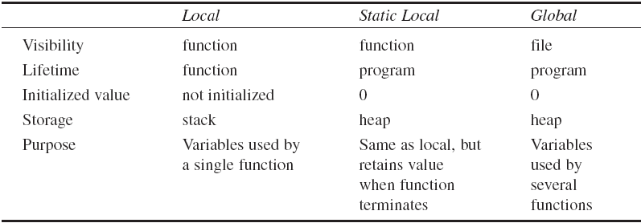
Summary of Variable Scopes

Slide 30
Exercises
Page 212 – 213
Ex. 1 to 12

